Slide 1

CSE 464 : Software Quality Assurance and Testing
Intro to Web Application Security Testing
Janaka Balasooriya

Slide 2
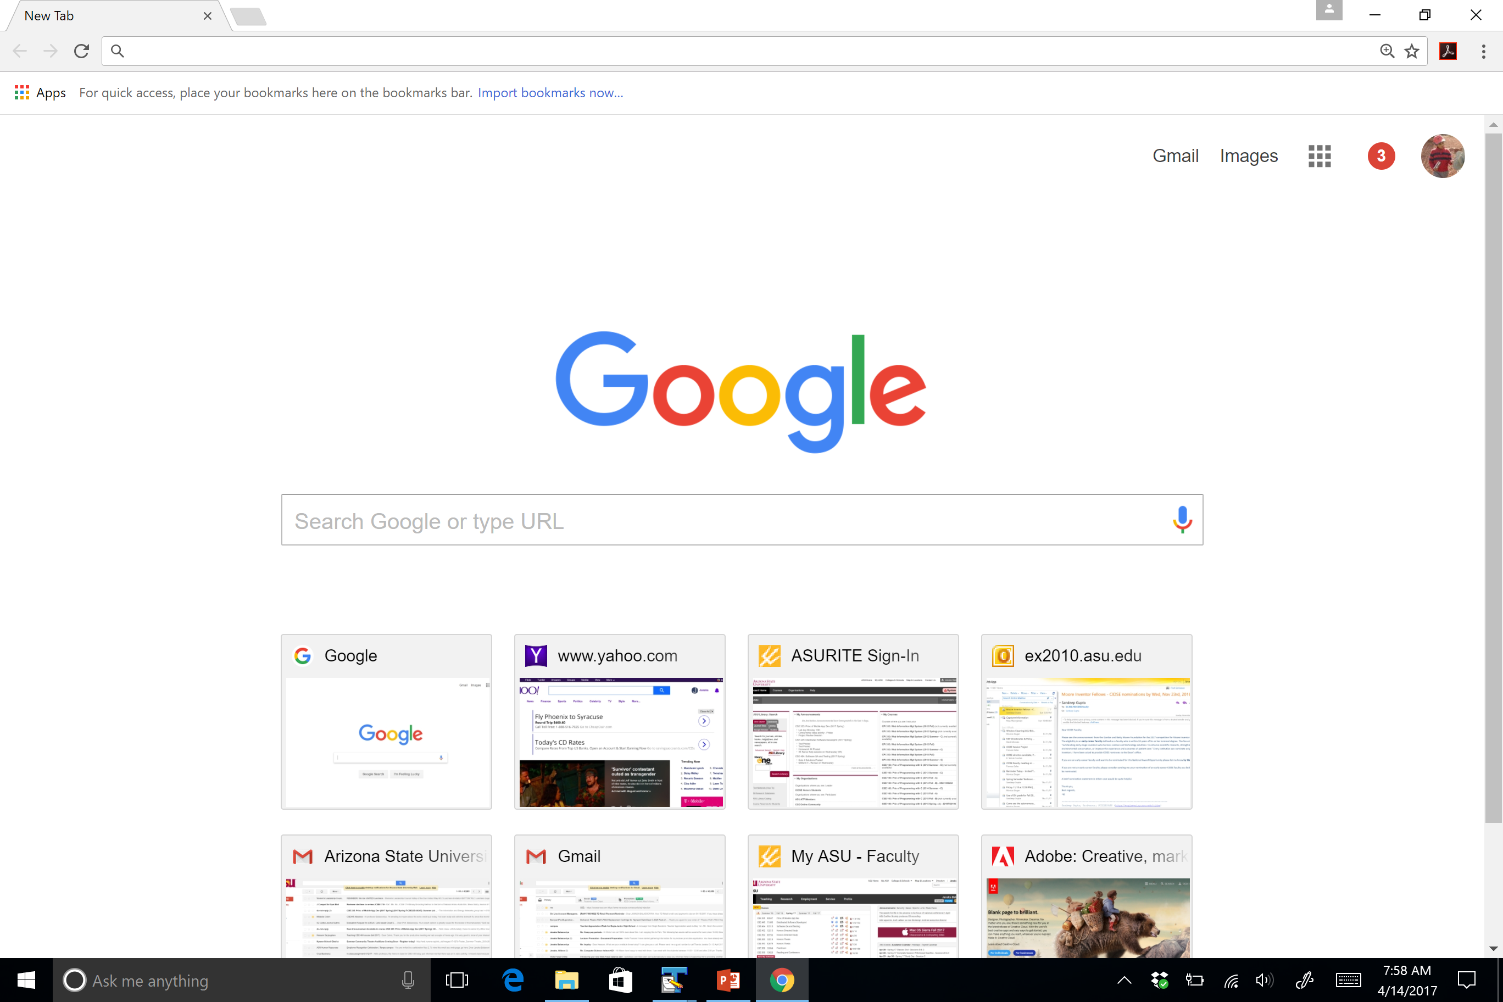
Security Vulnerabilities of Web Applications
According to Open Web Application Security Project, 10 diffident vulnerabilities are identified. When security testing is carried out, these categories can be considered as classes of inputs for security tests, similar to equivalent partitions.
Broken authentication and Session Management
Injection
Cross-Site Scripting
Unprotected APIs
Broken Access Control
Using components with unknown Vulnerabilities
Security Misconfiguration
Cross-Site Request Forgery
Sensitive Data Exposure
Insufficient Attack Protection
https://owasp.org/www-project-top-ten/

Slide 3
Injection
In general, injection is the term use to describe the scenario where
user input for the web application is altered
give an input that can harm the web application/access resources intentionally or data in the web application without proper authentication.
Sql injection is one of the common issues related web applications security. It is an application security weakness that allows attackers to control the web application’s database such as unauthorized login, delete/alter tables …etc. This happens due to the nature of how we write SQL queries and how databases process SQL queries
SQL Injection Examples:
Returning more data than expected:
SELECT accountNumber, balance FROM accounts WHERE account_owner_id = 984
If we change the query so that
SELECT accountNumber, balance FROM accounts WHERE account_owner_id = 0 OR 1=1
2) Multi-Statement (S1; S2)
  SELECT * FROM `table`; DROP TABLE `table`;

Slide 4
SQL Injection Examples https://www.w3schools.com/sql/sql_injection.asp

Slide 5
Preventing SQL Injection
Using prepared statements in the server-side code:
String accountBalanceQuery =
"SELECT accountNumber, balance FROM accounts WHERE account_owner_id = ?";
try {
PreparedStatement statement = connection.prepareStatement(accountBalanceQuery);
statement.setInt(1, request.getParameter("user_id"));
ResultSet rs = statement.executeQuery();
while (rs.next()) {
page.addTableRow(rs.getInt("accountNumber"), rs.getFloat("balance"));
}
} catch (SQLException e) { ... }

Slide 6
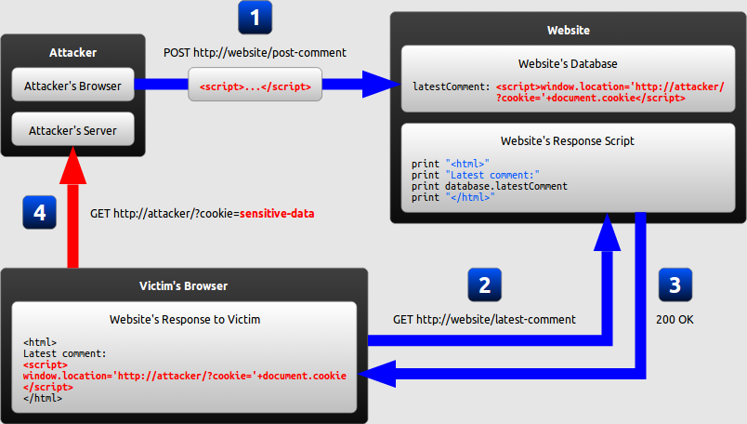
XSS : Cross-Site Scripting
Cross-site scripting (XSS) is a code injection attack that allows an attacker to execute malicious script in another user’s browser. It essentially, helps the attacker to gain access to a website through another user.
The attacker uses one of the website's forms to insert a malicious string into the website's database.
The victim requests a page from the website.
The website includes the malicious string from the database in the response and sends it to the victim.
The victim's browser executes the malicious script inside the response, sending the victim's cookies to the attacker's server.

Slide 7
References
Open web application security project top 10 : https://www.owasp.org/index.php/Category:OWASP_Top_Ten_Project
https://excess-xss.com/
https://www.veracode.com/security/sql-injection

